Slide 1









A Comprehensive Dashboard of Key Metrics and Performance Indicators
CASE STUDY
Client Challenge
Our Solution
Outcome
The client wanted to have an automated Human Resource Dashboard to track, analyze and report on HR KPIs.
The firm was looking for:
The company decided to use Infomineo’ Data Analytics service as a solution to cover:
The firm recognized that the quality of the Data Analytics service provided a useful reporting tool resulting in:
- During the project, Data was corrected in the ERPs :
Manual files were not used anymore
Data Quality improved by 75% for critical data elements
- Estimated 1 FTE from the HR department could be reallocated to other tasks
- Helped the company to start its Data Transformation
- Infomineo has been asked to work with client’s Finance Team to create another dashboard
Data Quality & Consistency problems between the various Data sources
Effective and quick solution
Smooth integration with its existing ERPs
Dashboard creation that reflects HR Team needs
Lower cost than buying from a specialized company an HR Dashboard tool
Ad-hoc deliverables :
Dictionaries, Creation of Metadata, Data Quality on boarding

Slide 2
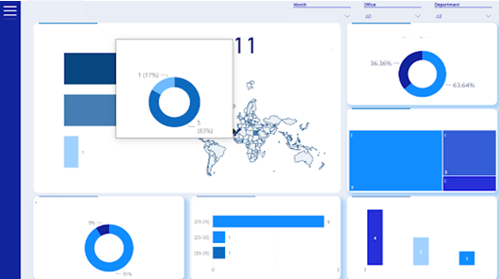
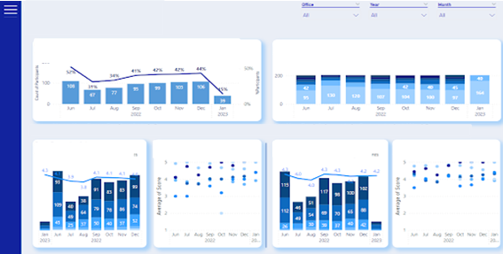
A Comprehensive Dashboard of Key Metrics and Performance Indicators
Achievements
A data model has been elaborated considering that 5 tools were identified to contain the Data source needed
14 source reports have been created and their extractions’ have been automatized using APIs
Data Quality Checks have been automatized given business rules
The Report created contained 3 main sections : Administrative, Professional Development, Recruitment
30 Dashboards are in the report and + 150 graphs have been created and + 50 KPIs

Slide 3
Assessing Candidate Experience through Sentiment Analysis
CASE STUDY
Client Challenge
Our Solution
Outcome
The client collects large amounts of candidates' feedback data during the recruitment process and was looking for ways to analyze the data received through a survey.
The firm was looking for:
Infomineo’ s Data Analytics team addressed the client’s challenges by:
The analysis provided the client with a comprehensive overview of candidate sentiments, enabling them to identify areas of strength and areas for improvement in the recruitment process.
In addition, the results of the analysis enabled the client to re-evaluate its recruitment procedures and make data-driven decisions to improve the candidate experience at the global, regional, country and departmental level.
The results also helped the client develop new perspectives on the power of AI-powered tools in streamlining and enhancing the analysis of large datasets
Conducted sentiment analysis using the state-of-the-art language model Roberta to analyze candidate feedback and extract the overall sentiment
Utilized AI-powered text summarization through Open AI's GPT-3 to extract key insights from candidate comments, focusing on areas of concern such as discrimination and unprofessionalism and showing the specific comments.
Automated tool to analyse candidate feedback as opposed to doing it manually
Generate relevant insights from the analysed data to improve the candidate recruitment experience
Dashboard creation :
Allowing for easy filtering of feedback and candidate sentiment

Slide 4
Assessing Candidate Experience through Sentiment Analysis
Distinguishing Positive and Negative Feedback candidates’ comments
Highlighting Critical Insights: Advanced Text Summarization and GPT-3 Driven Categorization
Leveraging pre-trained Roberta Model
Candidates’ feedback cleaning and pre-processing to ensure optimal input for the model.
Using "sentiment-Roberta-large model” as is for a start modelization.
Creating Embeddings for Candidate Comments
Tokenizing candidate comments custom NLP techniques and open-source tools
Generating high-dimensional vector representations (embeddings) for each comment via OpenAI's Embeddings API to enhance performance.
Large Language Models Utilizations
Fine-tuning the model to client-needs
Identify limitations in the pre-trained model’s
Manual labelization of a representative sample of candidates’ feedback data
Fine-tuning the model using the labeled data to better handle nuances and provide more accurate sentiment analysis results.
Exploiting OpenAI's GPT-3 API for Text Summarization
Utilizing GPT-3 model, to perform targeted text summarization
Providing the model with trained embeddings and specific summarization objectives for precise insight extraction
Heading
Integrating the fine-tuned model with the ETL pipeline, automating sentiment analysis on incoming data
Dashboarding for dynamic visualization of key insights, trends, and actionable feedback categories
Prioritizing and Categorizing Comments
Instructing GPT-3 to prioritize comments related to topics specified by the client : Discrimination, Rudeness, Suggested Improvements
Appling custom filters and thresholds to fine-tune the categorization and selection of comments

Slide 5
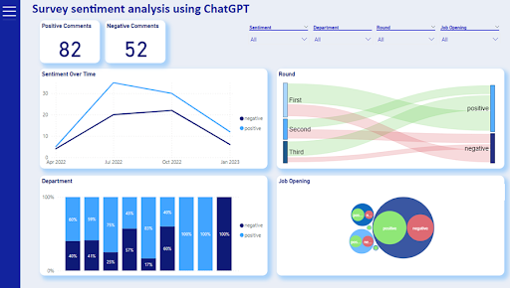
Assessing Candidate Experience through Sentiment Analysis

Slide 6
Web Scraping Tool for Second-Hand Car Sales and Accurate Pricing Predictions Based on Car Specifications
CASE STUDY
Client Challenge
Our Solution
Outcome

Slide 7
CASE STUDY
Data Collection and Analysis: Automobile Practice
Client Challenge
Our Solution
Outcome
To aid analysis for projects in the automobile sector, the client needed to collect data from an e-commerce platform and analyse this data.
The firm was looking for an efficient :
Infomineo’ s Data Analytics delivered:
A full-fledged webscraping tool, operable through a user interface was delivered to the client.
The solution enabled the client to extract listings from the e-commerce platform, across all cities and categories, using specific keywords.
This data and the insights generated will then be used by the client when developing strategy propositions for corporate clients served by its automobile practice.
An end-to-end solution using Python, wrapped in a Graphical User Interface (GUI) to improve user experience. In addition, the solution was delivered as a Pypi package
An efficient and effective way to regularly collect data from an e-commerce website which operates in Morocco
Using the data collected, generate relevant insights that are relevant to one of the client’s practice areas

Slide 8
Time Series Analysis: Real Estate
CASE STUDY
Client Challenge
Our Solution
Outcome
Thanks to the web app, in a few clicks, a price can be computed for any real estate asset, for forecasting or pricing, on any platform.
Client:
The client was looking for a tool which would allow them carry out an in-depth analysis of its portfolio assets, estimate real estate prices in their operating markets and assist in planning for potential investments.
The firm was looking for :
The company decided to use Infomineo’s Data Analytics service as a solution to cover:
A real estate investment company
Machine Learning algorithms
Using state delivered transactions as well as exogenous data
Before the project, senior executives in the company including the CEO relied on price estimates provided by an analyst which involved comparing prices across similar communities.
This approach was time-consuming, oftentimes inaccurate, and offered no trend analysis or provided forecasts
Informative and quick solution
Dashboard creation fast and high quality dashboarding
Fast computing and easy access
With a web app including dashboards
Ad-hoc deliverables :
Web App
in depth understanding of current market and on a particular asset
The firm recognized that the quality of the Data Analytics service provided a consistently useful tool and Infomineo also delivered a case study on a set of assets and provided real time updating of the solution.

Slide 9
Time Series Analysis: Real Estate
xxx
Presentation
Asia
Europe
US
Africa
Middle East
Request
The project’s objective was to deliver a forecasting method of Dubai real estate market and compare “The Sustainable City” to its direct competitors.
Main challenges
Performing a relevant clustering and analysis of Dubai’s real estate projects, with 1M rows over 15 years.
Identifying time related trends in the market.
Estimate the price of any real estate asset located in Dubai with a precision emphasis.
Dubai doesn’t provide any detailed socio-demographic data; therefore, external features are only USD index, Dubai stock market index, oil&gaz index and AED Index.
Infomineo’s approach
Data cleaning, Data Vizualisation, feature engineering.
Using K-means clustering with elbow approach to determine the cluster where The Sustainable City is.
Perform statistical analysis of time series predictions for the TSC and its direct competitors.
Compute and fine tune time series algorithms : NPTS, Simple feed forward, ARIMA, SARIMAX, seasonal trends, Transformer …
Predict the price of any asset through Machine learning algorithms : tree based, neuronal networks, regressions …
Deliverable
A web-app for data visualization, mapping and price-prediction tools
A presentation to introduce the application and detail our work and our assumptions

